Slide 1
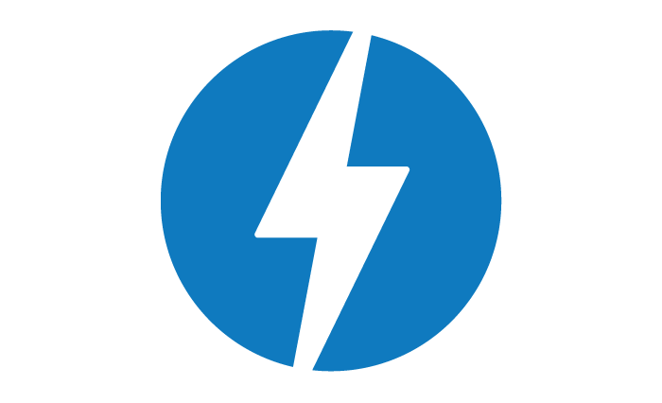

ACCELERATED MOBILE PAGES PROJECT
1

Slide 2
Till Now…What happens?
Whenever you surf the internet on your mobile and come across a really interesting article with a tempting title.
You tap on the article link, but then you have to wait and,
wait for more.
Well done! If you successfully waited for the article to appear,
then you are among the most patient mobile readers.
More and more people consume content via their mobile phones, but mobile performance is still a serious issue.
What does this mean for vendors?
If your website has a slow loading time, this is what your readers have to contend with every time they click on your article.
Every time a page loads slower, you lose readers, which means lower subscription rates and, less ad revenue.
2

Slide 3
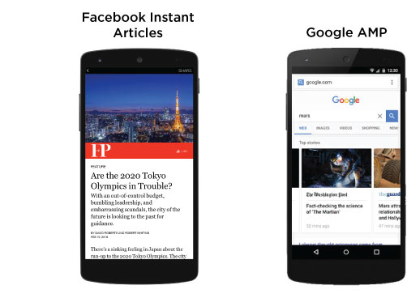
Solutions & why AMP?
In 2015, Facebook and Google introduced initiatives for design to improve the mobile web experience for users. Both share the goal of making pages that load faster and use less data than desktop pages.
Facebook Instant Articles
Articles only appear inside the Facebook app
Google AMP
AMP articles appear inside your mobile web browser
It also appears on Google search pages.
3

Slide 4
What is AMP?
Accelerated Mobile Pages are basically designed to provide a great user experience on mobile.
The framework allows to build easy, accessible and customized web pages with faster loading speed.
The speed of loading, which is seriously rapid, will also provide the biggest clue to the fact, that there is something different about the page; note that AMP pages have had many of the elements that contribute to slow loading times removed, allowing the page to load up to 85% faster than non-AMP pages.
4

Slide 5
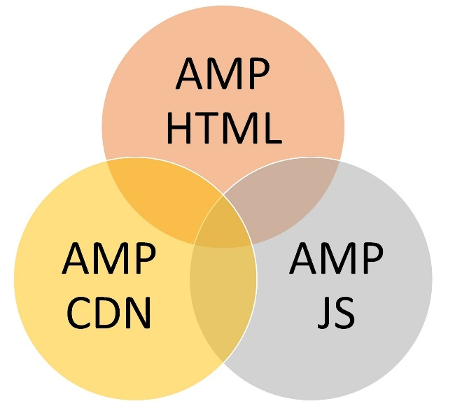
AMP Components
AMP HTML : a subset of HTML with custom tags, properties and restrictions.
AMP JS : JavaScript framework for mobile pages.
Google AMP Cache (AMP CDN) : a content delivery network (optional), which automatically caches and improves your AMP-enabled pages’ performance.
5

Slide 6
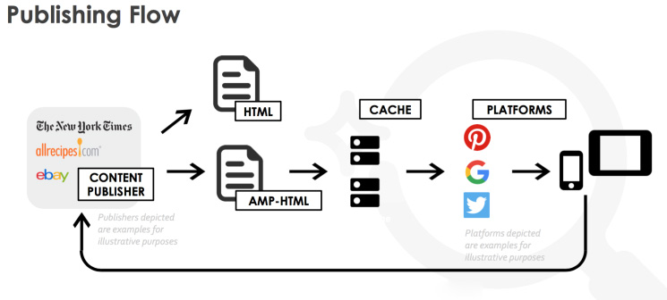
How Google AMP Works?
To use AMP, you should create an alternate version of your website that meets with strict requirements. This gives your AMP-optimized site a separate address, such as: yourdomain.com/page/amp.
AMP achieves its remarkable loading speed in two ways:
Streamlining website code (eliminating third-party JavaScript's and slow elements from the code)
Serving pages from its own high performance global servers when you visit an AMP article
If a user searches for an article on mobile and this article has a valid AMP version, the search directs the mobile user to the cached AMP version of the article.
Publishing Flow
6

Slide 7
AMP Features
AMP provides some guidelines or recommendations to use the AMP benefit.
Custom HTML tags which help us to make the AMP html, i.e. amp-img, amp-iframe, amp-carousel etc.
Provides Responsive Power to make the AMP pages responsive which help to run the page across all the devices.
AMP provides inbuilt UI features like Light Box, Accordion, sidebar, social icons etc.
AMP provides search engine optimization (SEO) support with amp-analytics tags.
7

Slide 8
AMP Specific HTML Tags
Tag Name | AMP HTML
Img | Replaced with amp-img.
Video | Replaced with amp-video.
Audio | Replaced with amp-audio.
Iframe | Replaced with amp-iframe.
Style | Replaced with style amp-custom.
8

Slide 9
AMP Specific Tags
<amp-lightbox>…..</amp-lightbox> | <amp-font>…..</amp-font>
<amp-anim>…..</amp-anim> | <amp-youtube>….</amp-youtube>
<amp-vine>….</amp-vine> | <amp-instagram>….</amp-instagram>
<amp-pixel>….</amp-pixel> | <amp-audio>….</amp-audio>
<amp-ad>….</amp-ad> | <amp-carousel>….</amp-carousel>
<amp-twitter>….</amp-twitter> | <amp-iframe>….</amp-iframe>
For more tags: https://www.ampproject.org/docs/reference/extended.html
9

Slide 10
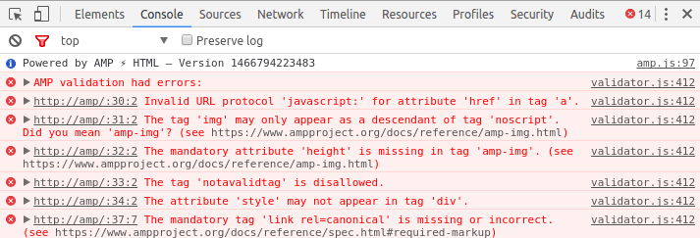

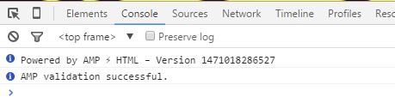

How do I check if my page is valid AMP ?
The key strength of AMP isn’t just that it makes your pages fast, but that it makes your pages fast in a way that can be validated. This way, third parties such as Twitter, Instagram or Google Search can feel great about serving AMP pages to readers in increasingly interesting ways.
The AMP Validator comes bundled with the AMP JS library, so it is available on every AMP page out of the box. To validate:
Open your AMP page in your browser.
Append "#development=1" to the URL,
For example,http://localhost:8000/
released.amp.html#development=1.
Open the Chrome DevTools console pressing F12
and then check for validation error.
10

Slide 11
Benefits
Fast loading page for mobile users.
Improved search engine ranking.
Increased visibility for Publishers.
Support for Ads.
AMP Visitor Analytics.
Publishers supporting AMP: BBC, Sankei, New York Times, News Corp and Washington Post and more.
Technology providers supporting AMP: Twitter, Pinterest, WordPress.com, Chartbeat, Parse.ly, Adobe Analytics and
LinkedIn.
11

Slide 12
Restrictions
Generating leads is restricted, since third-party forms are currently not allowed but there is a solution to add lead capturing forms.
Third-party JavaScript's are not permitted, which means that if you’re not using Google Analytics or one of Google partners for tracking, you may be out of luck.
Publishers became highly dependent on Google’s user experience standards and ad requirements.
AMP restricts what you can do in HTML pages, so fancy design is stripped out in favor of speed.
Publishers have to make sure that every page is free of errors before Google will even pick it up and put in the AMP cache. It could demand more developer hours.
12

Slide 13
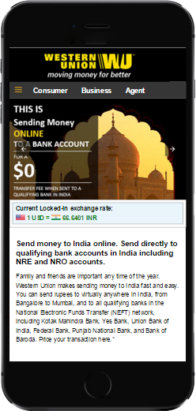
POC
We have created a POC using AMP for our client
Western Union. It was well appreciated by the client and the higher authorities.
And, Google has also included the Western Union AMP page in their repository.
https://cdn.ampproject.org/c/www.westernunion.com/us/en/amp/send-money-to-india.html
13

Slide 14
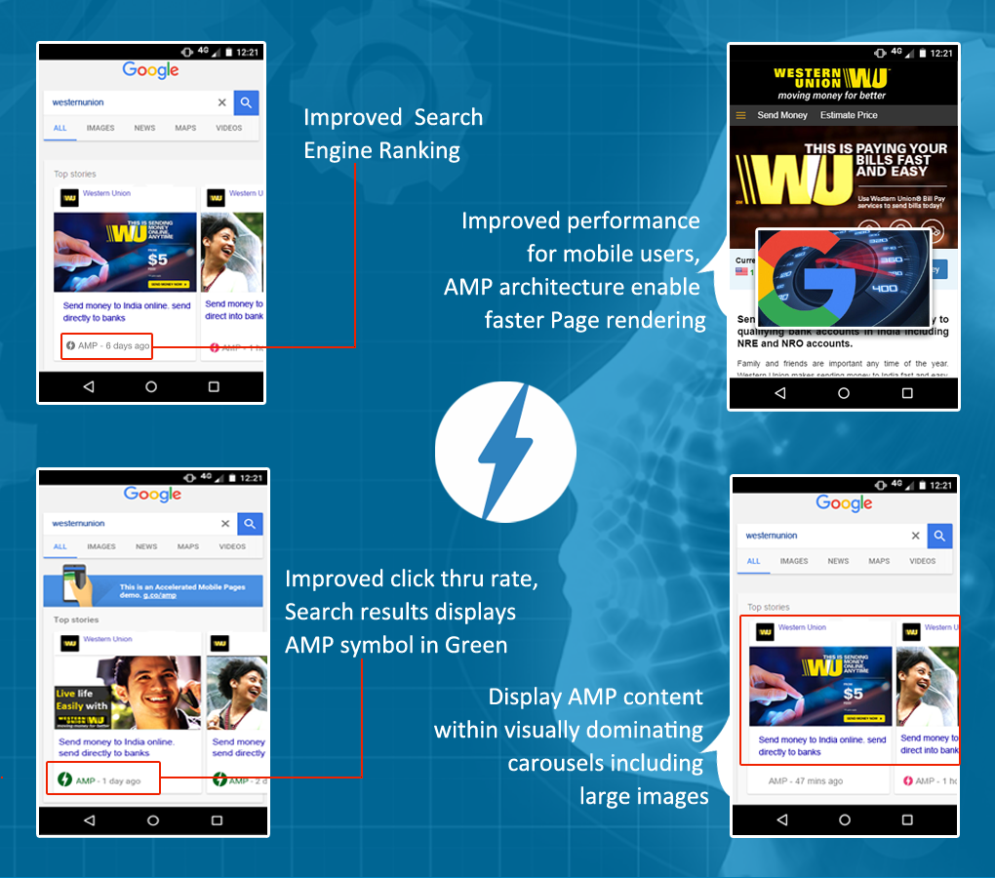
14

Slide 15








Well known Clients
15

Slide 16
References
https://www.ampproject.org/docs/get_started/about-amp.html
http://www.blackboxdesign.com.au/how-googles-amp-will-transform-mobile-web/
https://www.netgains.org/blog/impact-of-google-accelerated-mobile-pages-amp-in-seo/
https://searchenginewatch.com/2016/02/22/what-will-googles-accelerated-mobile-pages-amp-mean-for-marketers/
16

Slide 17

Questions ?
17
17

Slide 18
Thank you
18

